Slide 1
Dr.SNS RAJALAKSHMI COLLEGE OF ARTS AND SCIENCE (AUTONOMOUS) COIMBATORE-641049 Accredited by NAAC(Cycle III) with “A+” Grade Recognised by UGC, Approved by AICTE, New Delhi and Affiliated to Bharathiar University, Coimbatore.
DEPARTMENT OF COMPUTER SCIENCE
18UCS810: MOBILE APPLICATION DEVELOPMENT(Blended)
III YEAR - V SEM
UNIT 2 – Android Application Design Essentials
TOPIC – Permission

Slide 2
Outline
Permission
Permission approval
Types of Permission
List of App Permissions
Managing App Resources

Slide 3
Permission
The purpose of a permission is to protect the privacy of an Android user.
Android apps must request permission to access sensitive user data (such as contacts and SMS), as well as certain system features (such as camera and internet).

Slide 4
Permission approval
An app must publicize the permissions it requires by including <uses-permission> tags in the app manifest
<manifest xmlns:android="http://schemas.android.com/apk/res/android" package="com.example.snazzyapp">
<uses-permission android:name="android.permission.SEND_SMS"/> <application ...> ... </application> </manifest>

Slide 5
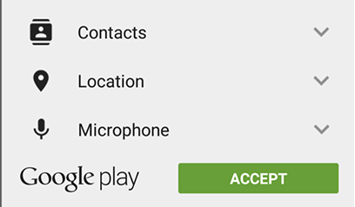
Types of Permission
Install-Time Permissions: If the Android 5.1.1 (API 22) or lower, the permission is requested at the installation time at the Google Play Store.

Slide 6
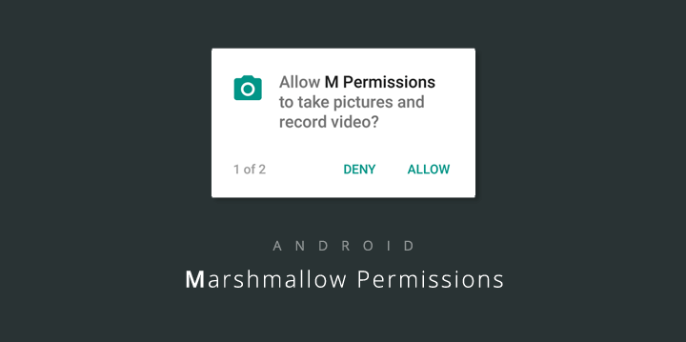
Run time permission
Run-Time Permissions: If the Android 6 (API 23) or higher, the permission is requested at the run time during the runnnig of the app.

Slide 7
Permission for listed App
Body Sensors – allows access to your health data and step count, from paired heart-rate monitors, fitness trackers, and other sensors.
Calendar – allows apps to read, create, edit, or delete your calendar events.
Camera – taking photos and recording video.
Contacts – read, create, or edit your contact list, as well as access the list of all accounts used on your device.
Location – access your location using GPS for high accuracy, and cellular data and Wi-Fi for approximate accuracy.
Microphone – used for recording audio, including for video.
Phone – access your phone number and network info. Required for making calls and VoIP, voicemail, call redirect, and editing call logs.
SMS – read, receive, and send MMS and SMS messages.

Slide 8
Managing App Resources
In Android,Various Resources are available for even static content implementation.
The static content of an application include bitmaps, background and text color, layout definitions, and many more.
All of this static content are generally located in different sub-directories under the root directory of the project i.e., res/.

Slide 9
Example : Organizing Application Resources Using Android Studio MyProject/ app/ manifest/ AndroidManifest.xml java/ MyActivity.java res/ drawable/ icon.png layout/ activity_main.xml info.xml values/ strings.xml contd…

Slide 10
Managing App Resources contd…
S. No. | Directory & Resource Type | Description
1 | anim/ | * XML files defining property animation * Resides in res/anim/ directory * You can access this resource with the help of R.anim class
2 | color/ | * XML files defining color state list * Resides in res/color/ directory * To access this resource, you need to access using R.color class
3 | drawable/ | * Consists of various image formats like .png, .jpg, .gif * Compiled XML files of bitmaps, state lists, shapes and animation * Resides in res/drawable/ directory * To access this resource, use R.drawable class

Slide 11
Managing App Resources contd…
S. No. | Directory & Resource Type | Description
4 | layout/ | * XML files defining user interface layouts for your application * Resides in res/layout/ directory * Access it with the help of R.layout class
5 | menu/ | * XML files defining various kinds of application menu * Resides in res/menu/ directory * It can be accessed through R.menu class
6 | raw/ | * Arbitrary files being stored in their raw or unprocessed form * Use R.raw.filename to call Resources.openRawResource() method * Resource ID – R.raw.filename used to open raw files

Slide 12
Managing App Resources contd…
S. No. | Resource Type | Description
7 | values/ | * XML files defining strings, integers, and colors Below are a few filename conventions for resources * arrays.xml – for resource arrays – can be accessed via R.array class * integer.xml – for resource integers – can be accessed via R.integer class * bools.xml – for resource boolean – can be accessed via R.bool class * colors.xml – for resource color values – can be accessed via R.color class * dimens.xml – for dimensional values – can be accessed via R.dimen class * strings.xml – for resource string values – can be accessed via R.string class * styles.xml – for resource styles – can be accessed via R.style class
8 | xml/ | * XML files which can be read at the runtime * To read these XML files, call Resources.getXML() method * Numerous configuration files can be stored in this directory

